Slide 1


The Web Conference 2024 (WWW 2024)
May 13-17, 2024 · Singapore
Unlocking the Non-deterministic Computing Power with Memory-Elastic Multi-Exit Neural Networks
Jiaming Huang, Yi Gao*, and Wei Dong*
College of Computer Science, Zhejiang University, China
Presenter: Jiaming Huang
Notes:
Hello everyone! I am Huang Jiaming.
Today, I will present our paper titled Unlocking the Non-deterministic Computing Power with Memory-Elastic Multi-Exit Neural Networks

Slide 2
Background
With the increasing demand for Web of Things (WoT) and edge computing, the efficient utilization of limited computing power on edge devices is becoming a crucial challenge.
Traditional neural networks (NNs) as web services rely on deterministic computational resources.
Notes:
With the increasing demand for Web of Things and edge computing, the efficient utilization of limited computing power on edge devices is becoming a crucial challenge.
Traditional neural networks as web services rely on deterministic computational resources.

Slide 3
Background
When facing non-deterministic computing power which could be preempted at any time, they may fail to output the results
preemption by high-priority tasks
degrade the task performance significantly!
[SIGCOMM’21]Concordia
Notes:
When facing non-deterministic computing power which could be preempted at any time, they may fail to output the results.
For example, Concordia views the 5G vRAN tasks as high-priority tasks and allocates dedicated computation resources to them, while all other workloads will be preempted unpredictably. (click)
This will degrade the task performance significantly.

Slide 4
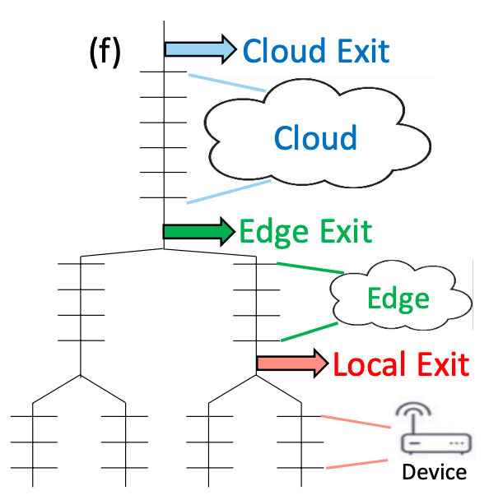
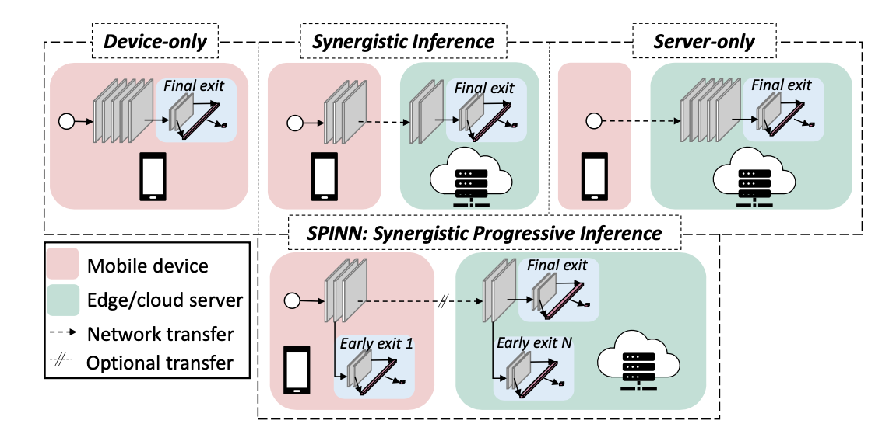
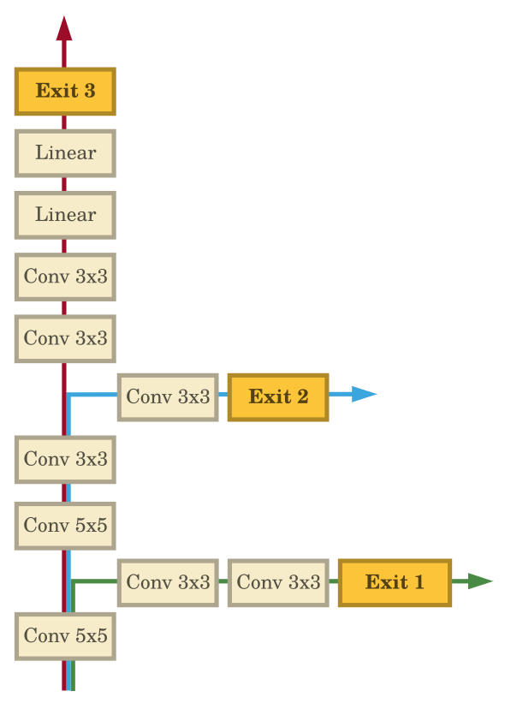
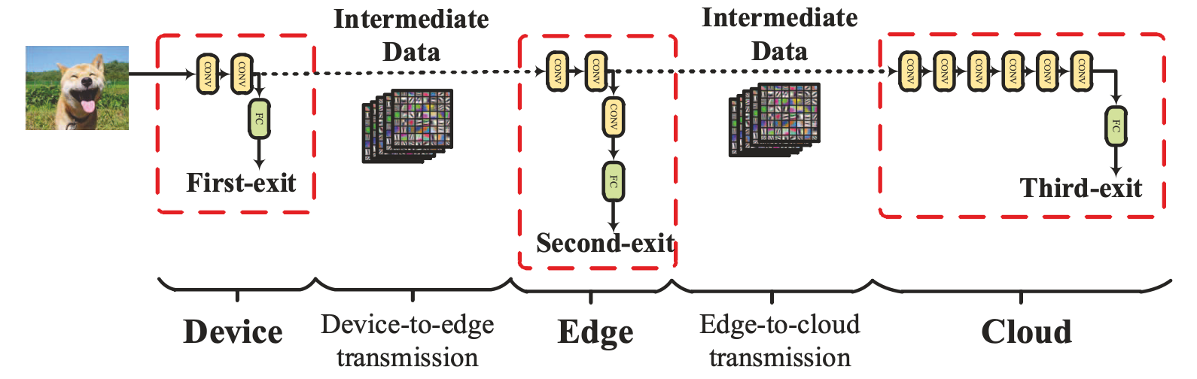
Background
In recent years, multi-exit neural networks have emerged and flourished in edge computing.
[ICPR’16] BranchyNet
[ICDCS’17] DDNN
[MobiCom’20] SPINN
✅
✅
[ICDCS’21]
LEIME
✅
Notes:
In recent years, multi-exit neural networks have emerged and flourished in edge computing. So, what does a multi-exit neural network look like?
Let us see BranchyNet. It can produce outputs at early exit branches to save time and memory overhead for subsequent inference.
Soon, they are widely applied to cloud-edge collaboration applications. Including, but not limited to, the three tasks here.
Such a Multi-exit structure allows applications to better leverage and coordinate computing capabilities (click) across the device, the edge, and the cloud.

Slide 5
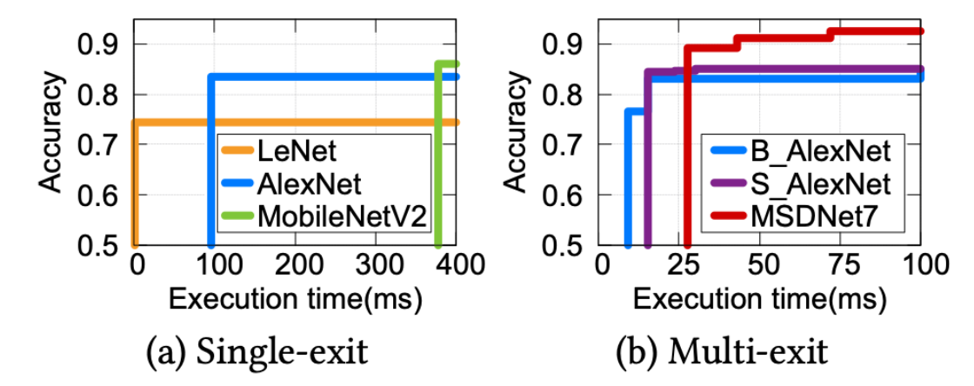
Single-exit vs. multi-exit model?
All single-exit inferences (i.e., complete execution of the model) encounter the issue of no inference results before the whole inference process is finished.
Multi-exit NNs can output more accurate inference results when they have more inference time.
Notes:
We did experiments to show how multi-exit models can achieve better inference performance when the computing resource can be preempted at any time.
All single-exit inferences (i.e., complete execution of the model) encounter the issue of no inference results before the whole inference process is finished.
Multi-exit NNs can output more accurate inference results when they have more inference time.

Slide 6
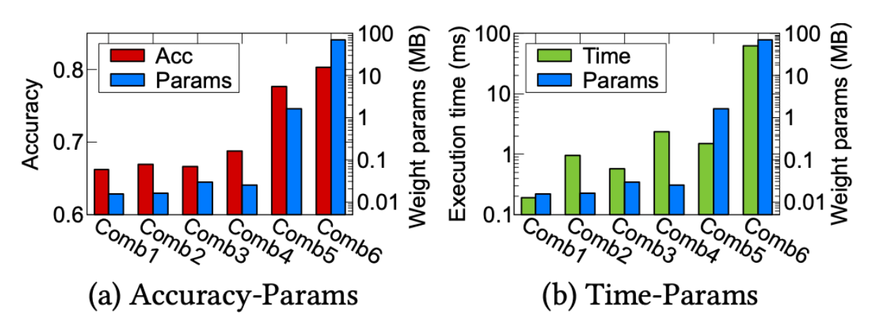
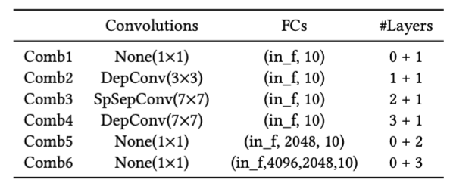
Static vs. dynamic branches?
Different branches have a significant impact on the execution time and accuracy of the same model at the same exit location.
Discovering dynamic branches that are both highly accurate and fast within available memory is an important task for multi-exit models.
Notes:
As for the inserted branches, different branches have a significant impact on the execution time and accuracy of the same model at the same exit location.
Discovering dynamic branches that are both highly accurate and fast within available memory is an important task for multi-exit models.

Slide 7
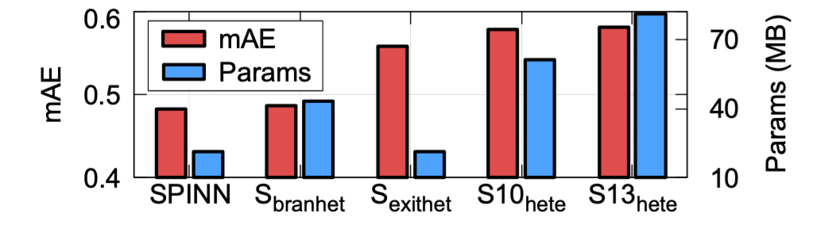
Homogeneous vs. heterogeneous branches?
When the branch structures are heterogeneous (S_{branhet}), the performance is improved.
When the exits are heterogeneous (S_{exithet}), there is a significant performance improvement while the model parameters are even reduced.
When increasing the number of heterogeneous branches (S10_{hete}, S13_{hete}), there is still a performance improvement.
Notes:
Previous research with homogeneous multi-exit models overlooks the diversity of branching structures.
We did experiments to explore the potential of heterogeneous branches.
When the branch structures are heterogeneous, the performance is improved.
When the exits are heterogeneous, there is a significant performance improvement while the model parameters are even reduced.
When increasing the number of heterogeneous branches, there is still a performance improvement.
Hence, it is beneficial to have heterogeneous branches in the multi-exit model.

Slide 8
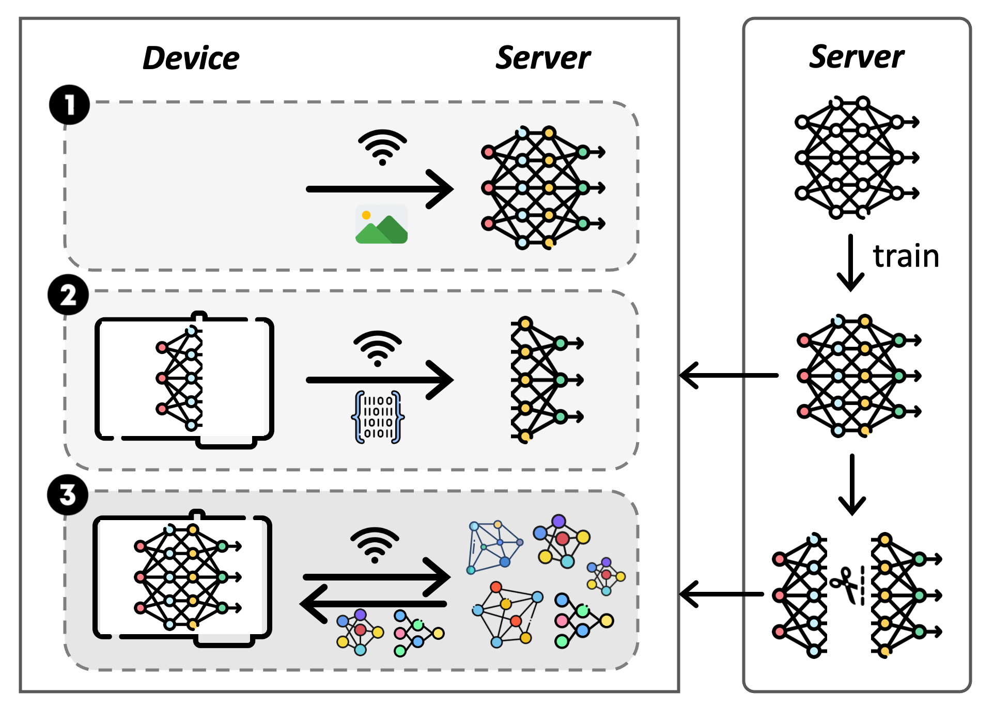
Design
We propose MEEdge to achieve automatic generations of heterogeneous and dynamic multi-exit models on resource-constraint devices at the edge.
Unlike traditional approaches of offloading or partially offloading models to servers, MEEdge implements branch updating from servers down to the device.
Notes:
Based on above motivations, we propose MEEdge to achieve automatic generations of heterogeneous and dynamic multi-exit models on resource-constraint devices at the edge.
Unlike traditional approaches of offloading or partially offloading models to servers, MEEdge implements branch updating from servers down to the device.

Slide 9
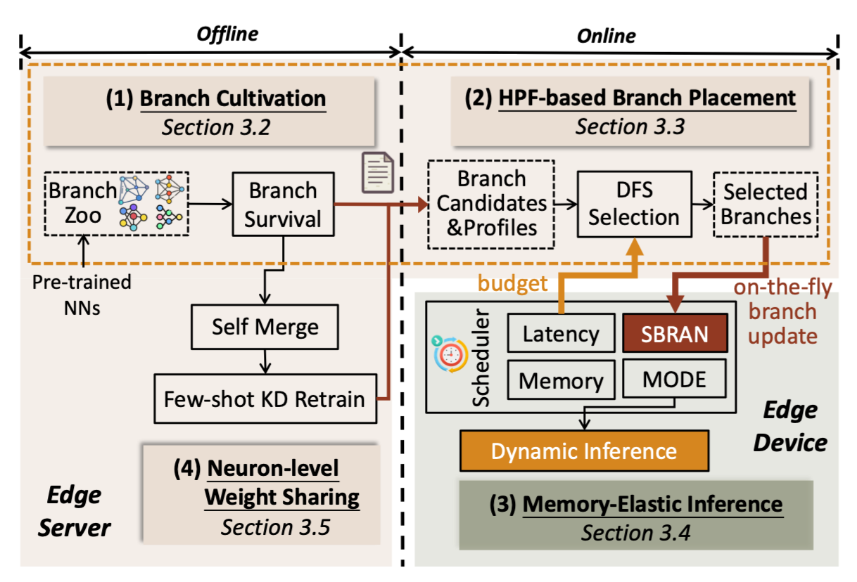
Overview of MEEdge
Four key techniques involved consist of both offline and online phases, incorporating both servers and devices at the edge.
For more details,
read our paper :)
Notes:
Next is the overview of MEEdge, four key techniques involved consist of both offline and online phases, incorporating both servers and devices at the edge.
For more details, you can read our paper!

Slide 10
a system that automatically transforms classic single-exit models into heterogeneous and dynamic multi-exit models which enables Memory-Elastic inference at the Edge.
MEEdge
Looking forward to meeting you in Singapore :)
Jiaming Huang
huangjm@zju.edu.cn
Notes:
Finally, MEEdge is a system that automatically transforms classic single-exit models into heterogeneous and dynamic multi-exit models which enables Memory-Elastic inference at the Edge.
Thank you for your attention. Looking forward to meeting you in Singapore.

